Slide 1
Content
What is internet?
What is web? www? uri—url
What is semantic web
Deference of normal web and semantic web
Architecture of s.w[3].
RDF[http://www.w3.org/RDF/]
Relation b/w semantic web and ERD(8)
Relational database.
Application of semantic web(wikipedia,2)
How can it be used?(2)

Slide 2
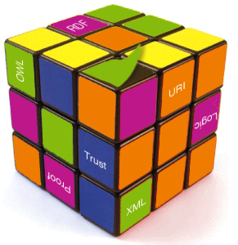
☺
RDF
RDFS
RIF and SWRL.
Benefit

Slide 3
Let know first,
What is Internet?
What is web/WWW?
What is URI & URL?

Slide 4
What is semantic web?
The Semantic Web is a web that is able to describe things in a way that computers can understand.
The Semantic Web provides a common framework that allows data to be shared and reused across application, enterprise, and community boundaries.

Slide 5
Deference of normal web and semantic web
1)World Wide Web (WWW) is a huge library of interlinked documents .
The focus of semantic web is to share data instead of documents.
2)

Slide 6
Architecture of Semantic Web

Slide 7
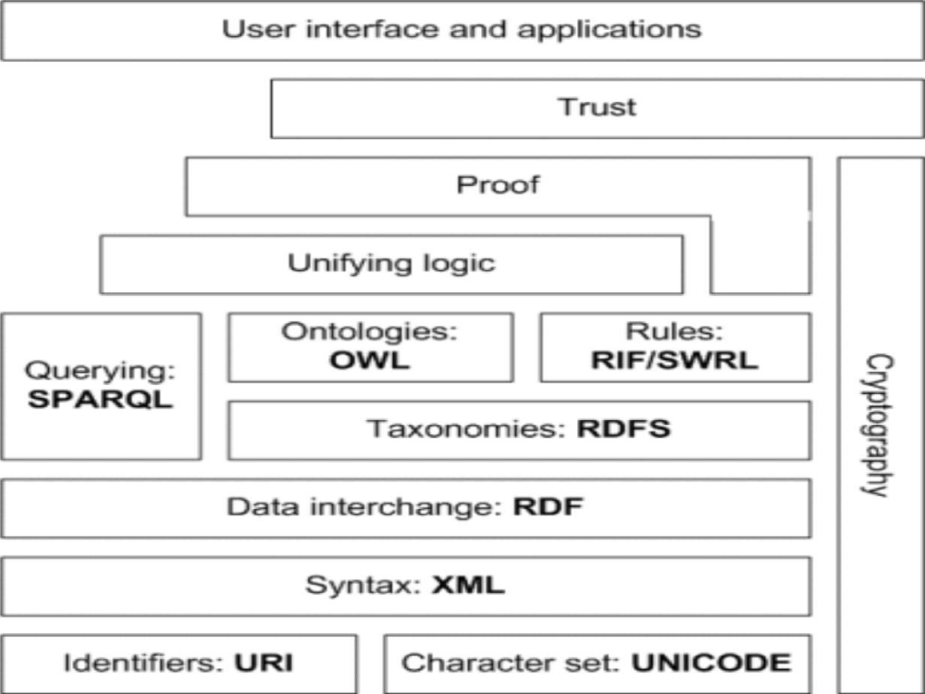

Slide 8
What is Ontology?
In the context of computer and information sciences, an ontology defines a set of representational primitives with which to model a domain of knowledge or discourse.
What is Taxonomy?

Slide 9
Resource Description Framework
This linking structure forms a directed, labeled graph, where the edges represent the named link between two resources, represented by the graph nodes. This graph view is the easiest possible mental model for RDF and is often used in easy-to-understand visual explanations.

Slide 10
Is the RDF model an entity-relationship mode?
Yes and no.
Relation with Relational
Database:
a record is an RDF node;
the field (column) name is RDF property Type;
the record field (table cell) is a value;

Slide 11
Benefits
The first five benefits of the technology are crucial: data integration across sources, expressive queries, taxonomy/multilingual, accessible for users, navigation and serendipity. If you start a project, you should try to get benefits in these areas.
Inferencing was not mentioned very often - although this can be of any reason (i.e. people forgot to mention it) it can also show that inference is important, but the web-based data integration features of RDF are also worth a lot. A little amount of semantics can go a long way.
The last two points, the web of data, and globally unique identifiers, are going to be much more important in the future and are a growing area.

Slide 12
Future Scope

Slide 13
Conclusion

Slide 14
Question?

Slide 15
Thank you
Have a good day…

